Slide 1




Slide 2

REMAINDER CYCLE

Slide 3
Cyclicity of Remainders:
Cyclicity of remainders is an important concept which can be used to solve questions based on remainders.
This concept utilizes the fact that remainders repeat themselves after a certain interval when divided by a number.
First of all, we know that Remainder = 0 to d – 1; where d= number by which the divisor is divided.
If we divide an by d, the remainder can be any value from 0 to d-1.
If we keep on increasing the value of n, the remainders are cyclical in nature.
The pattern of the remainders would repeat.

Slide 4
4ˆ1 divided by 9, leaves a remainder of 4.
4ˆ2 divided by 9, leaves a remainder of 7. {Rem(16/9) = 7}
4ˆ3 divided by 9, leaves a remainder of 1. {Rem (64/9) = 1}
4ˆ4 divided by 9, leaves a remainder of 4. {Rem (256/9) = 4}
4ˆ5 divided by 9, leaves a remainder of 4. {Rem (1024/9) = 7}
4ˆ6 divided by 9, leaves a remainder of 4. {Rem (4096/9) = 1}
4ˆ(3k+1) leaves a remainder of 4
4ˆ(3k+2) leaves a remainder of 7
4ˆ3k leaves a remainder of 1
As you can see above, the remainder when 4n is divided by 9 is cyclical in nature. The remainders obtained are 4, 7, 1, 4, 7, 1, 4, 7, 1 and so on. They will always follow the same pattern.

Slide 5
a^{n} when divided by d, will always give remainders which will have a pattern and will move in cycles of r such that r is less than or equal to d.
Let us apply this concept to some examples to getter a better understanding of it.

Slide 6
Explanation:
What will be the remainder when 41^43 is divided by 9?
Solution:
Step 1: We know that 41ˆ1 when divided by 9 gives a remainder= 5.
41ˆ2 when divided by 9 gives a remainder= 7.
41ˆ3 when divided by 9 gives a remainder= 8.
41ˆ4 when divided by 9 gives a remainder= 0.
41ˆ5 when divided by 9 gives a remainder=2.
41ˆ6 when divided by 9 gives a remainder= 1.
So, the cycle/pattern is 5,7,8,0, 2, and 1.
Step 2: The cyclicity is 6.
Step 3: 43 when divided by 6 is 1
Step 4: The answer is the 1st value in the cyclic pattern i.e. 5
Answer is 5.

Slide 7
Question: 01
Find out the remainder when 32ˆ32ˆ32 is divided by 7?
4
6
3
1
Notes:
A

Slide 8
Explanation: 01
Step 1: We know that 32ˆ1 when divided by 7 gives a remainder= 4
32ˆ2 when divided by 7 gives a remainder= 2.
32ˆ3 when divided by 7 gives a remainder= 1.
32ˆ4 when divided by 7 gives a remainder= 4.
32ˆ5 when divided by 7 gives a remainder= 2.
32ˆ6 when divided by 7 gives a remainder= 1.

Slide 9
Explanation: 01
Step 2: The cyclicity is 3.
Step 3: 32ˆ32 when divided by 3 is 1
Step 4: The answer is the 1st value in the cyclic pattern of 4, 2, and 1 i.e. 4.
Answer is 4.

Slide 10

Question: 02
What is the remainder when 17^200 is divided by 18?
3
1
15
17
Notes:
B

Slide 11
Explanation: 02
These type of questions become really simple if you understand the concept of negative remainders. Always try and reduce the dividend to 1 or -1.
= Rem [17^200 / 18]
= Rem [ (-1)^200 / 18]
= Rem [1 / 18]
= 1

Slide 12
Question: 01
Question: 03
What is the remainder when (71^71+71) is divided by 72?
9
2
70
63
Notes:
C

Slide 13
Explanation:
Explanation: 03
Ans: Rem [(71^71 + 71)/72]
= Rem [(71^71)/72] + Rem [71/72]
= Rem [(-1)^71] + (-1)
= (-1) + (-1)
= -2
= 72-2 = 70

Slide 14
Question: 04
What is the remainder when 19^98 is divided by 7?
8
2
0
4
Notes:
D

Slide 15
Explanation: 04
Rem [19^98/7]
= Rem [(-2)^98/7]
= Rem [2^98/7]
= Rem [ 2^96 * 2^2 / 7]
= Rem [ 8^32 * 4 / 7]
= Rem [1 * 4 / 7]
= 4

Slide 16
Question: 05
What is the remainder when 7^2015 is divided by 9?
7
8
4
1
Notes:
C

Slide 17
Explanation: 05
Rem [7^2015 / 9]
= Rem [(-2)^2015 / 9]
= Rem [ 4*(-2)^2013 / 9]
= Rem [ 4*(-8)^671 / 9]
= Rem [ 4*1 / 9]
= 4

Slide 18
Question: 06
What is the remainder when 2^2003 is divided by 17?
9
2
8
1
Notes:
C

Slide 19
Explanation: 06
Rem [2^2003 / 17]
= Rem [2^2000 * 8 /17]
= Rem [16^500 * 8 / 17]
= Rem [(-1)^500 * 8 / 17]
= Rem [ 1*8/17]
= 8

Slide 20
Question: 07
Find the remainder when 15^2010 +16^2011 is divided by 7 ?
2
1
6
3
Notes:
D

Slide 21
Explanation: 07
Here we need to know that:
Rem[(a + b)/c] = Rem[a/c] + Rem[b/c]
Rem[(a*b)/c] = Rem[a/c] * Rem[b/c]
Keeping that in mind:
Rem[15^2010/7] = Rem[1^2010/7] = 1
Rem[16^2011/7]
= Rem[2^2011/7]
= Rem[2^2010/7]*Rem[2/7]
= Rem[8^670/7] * 2
= 1*2 = 2
Rem[(15^2010 + 16^2011)/7] = 1 + 2 = 3

Slide 22
Question: 08
Find the remainder of 21^875 divided by 17?
3
4
14
13
Notes:
D

Slide 23
Explanation: 08
= Rem [4^875 / 17]
= Rem[4*4^874 / 17]
= Rem [4* 16^437 / 17]
= Rem [4*(-1)^437 / 17]
= Rem [4*(-1) / 17]
= Rem [-4 / 17]
= 13 Ans: Rem [21^875 / 17]

Slide 24
Question: 02
Question: 09
What is the remainder when 128^1000 is divided by 153?
72
52
16
36
Notes:
B

Slide 25
Explanation: 09
We have to find out Rem [128^1000/153]
This looks a little difficult if you do not any theorems for finding out remainders. Let us take a simpler approach and break down the problem into smaller parts.
These type of questions become really simple if you understand the concept of negative remainders. Always try and reduce the dividend to 1 or -1.
153 = 9*17
128^1000 = 2^7000
Let us find out Rem[2^7000/9] and Rem[2^7000/17]
We will combine them later.
Rem[2^7000/9]
= Rem [ 2^6999 x 2 / 9]
= Rem [ 8^2333 x 2 / 9]
= Rem [ (-1)^2333 x 2 / 9]
= Rem [ (-1) x 2 / 9]
= – 2 from 9
= 7

Slide 26
Explanation: 09
Rem[2^7000/17]
= Rem [16^1750 / 17]
= Rem [ (-1)^1750 / 17]
= 1
So, our answer is a number which leaves a remainder of 7 when divided by 9 and it should leave a remainder of 1 when divided by 17.
Let us start considering all numbers that leave a remainder of 1 when divided by 17
= 18 (leaves a remainder of 0 from 9. Invalid)
= 35 (leaves a remainder of 8 from 9. Invalid)
= 52 (leaves a remainder of 7 from 9. Valid. This is our answer)

Slide 27
Question: 10
Find the remainder when 7^26 is divided by 100?
52
23
49
51
Notes:
C

Slide 28
Explanation: 10
Finding out the remainder from 100, is the same as finding out the last two digits of a number
Last two digits of 7^1 are 07
Last two digits of 7^2 are 49
Last two digits of 7^3 are 43
Last two digits of 7^4 are 01
After this, the same pattern will keep on repeating.
So, 7^(4n+1) will end in 07, 7^(4n+2) will end in 49, 7^(4n + 3) will end in 43, and 7^4n will end in 01
7^26 = 7^(4n+2) will end in 49
= Rem [7^26/100] = 49

Slide 29
Question: 04
Question: 11
25^102 divided by 17 gives the remainder as
4
7
8
13
Notes:
A

Slide 30
Explanation:
Explanation: 11
25^102 / 17 = 8^102 / 17 = (2^3)102 / 17 = 2^306 / 17
= ((2^4)76 * 2^2) / 17
= (-1)76 * 4 / 17 = 4/17 = Remainder is 4

Slide 31
Question: 12
Find the remainder when 1! + 2! + 3! +4! + 5! + ————– 1000! is divided by 14?
1
9
2
5
Notes:
D

Slide 32
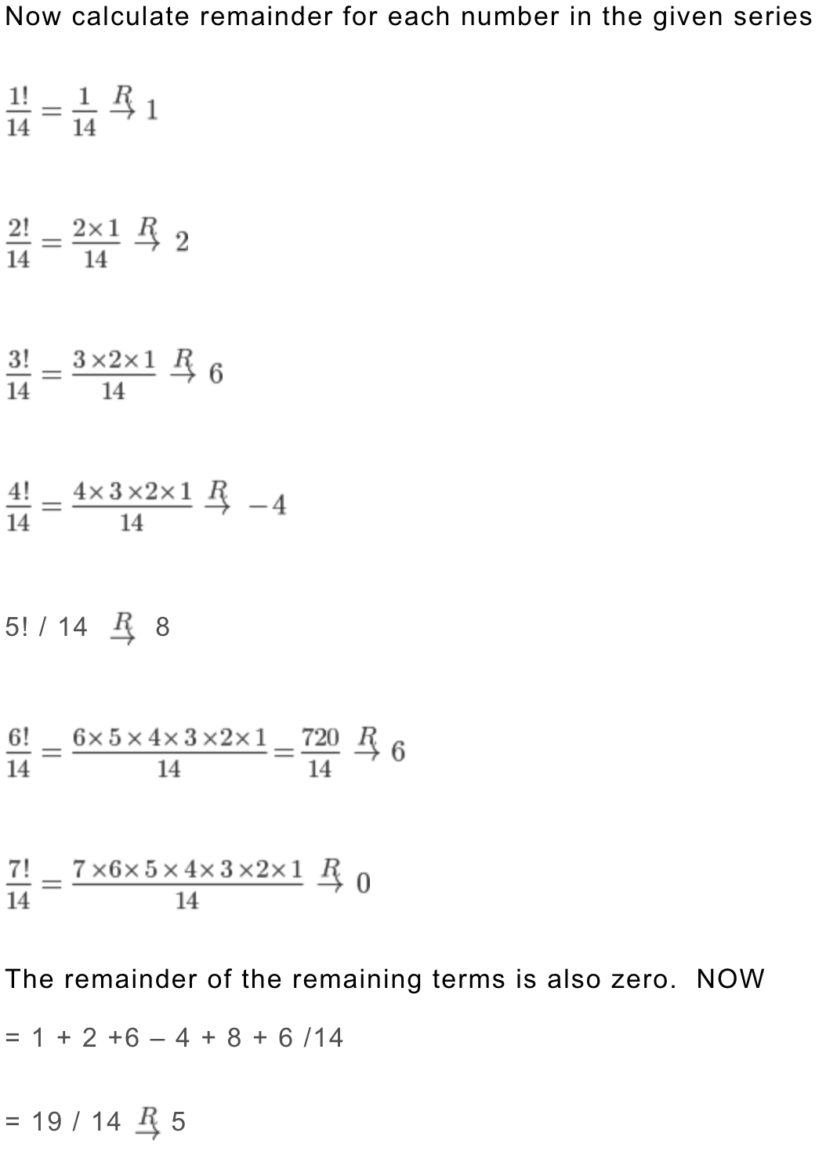
Explanation:
Explanation: 12

Slide 33
Question: 13
Find the remainder when 1! + 2! + 3! +4! + 5! + ————– 1000! is divided by 8?
1
4
7
6
Notes:
A

Slide 34
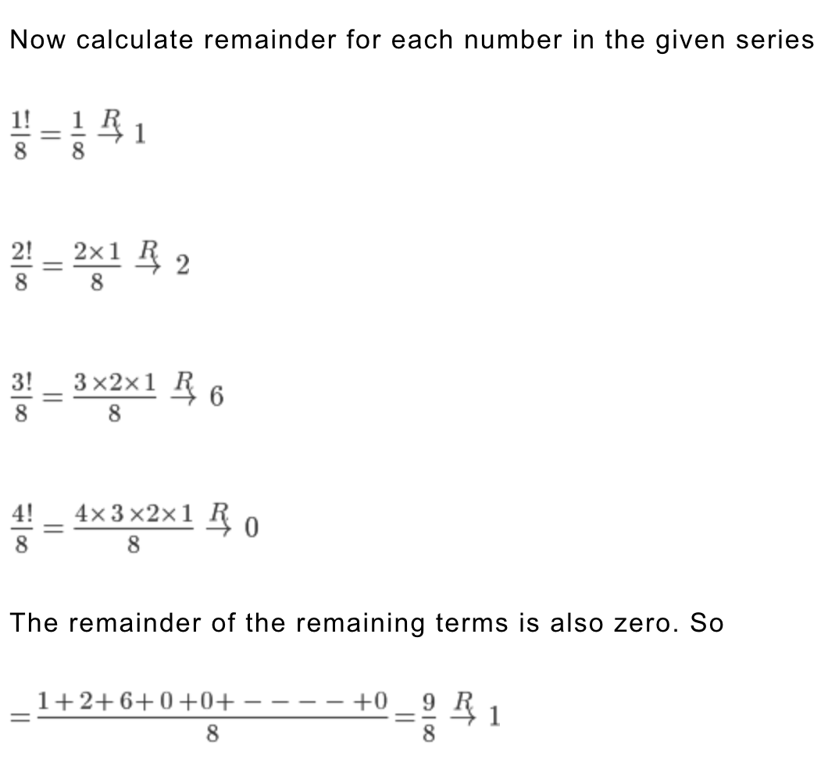
Explanation:
Explanation: 13

Slide 35
Question: 14
What is the remainder when 767^1009 is divided by 25?
18
15
22
516
Notes:
C

Slide 36
Explanation: 14
Remainder of a number from 25 will be the same as the remainder of the last two digits of the number from 25.
For finding out the last two digits of an odd number raised to a power, we should first try and reduce the base to a number ending in 1.
After that, we can use the property
Last two digits of (…a1)^(…b) will be [Last digit of a*b]1

Slide 37
Explanation: 14
Let us try and apply this concept in the given question
Last two digits of 767^1009
= Last two digits of 67^1009
= Last two digits of 67*67^1008
= Last two digits of 67*(67^2)^504
= Last two digits of 67*(..89)^504
= Last two digits of 67*((..89)^2)^252
= Last two digits of 67*(…21)^252
= Last two digts of 67*(…41) {Here I have used the property mentioned above}
= 47
Rem [767^1009 / 25]
= Rem [47/25]
= 22

Slide 38
Question: 15
What is the remainder when 2^1040 is divided by 131?
91
72
1
8
Notes:
C

Slide 39
Explanation:
Explanation: 15
We have to find out Rem [2^1040/131]
As per Fermat’s Theorem, [a^(p-1)/p] = 1 where p is a prime number and HCF(a,p) = 1
Rem [2^130 / 131] = 1
= Rem [(2^130)^8 / 131] = 1
= Rem [2^1040 / 131] = 1

Slide 40

https://learn.codemithra.com

Slide 41




THANK YOU
+91 78150 95095
codemithra@ethnus.com
www.codemithra.com

